Slide 1

Long-term Care Services
671 Module 6 Lecture

Slide 2

Objectives:
Assess long-term care (LTC) and why it is needed.
Discuss the users of LTC services and their unique needs.
Determine the various services incorporated in LTC delivery.
Examine how LTC is funded.

Slide 3
Long-term care defined:
Long-term care is defined as a variety of individualized, well-coordinated services that promote the maximum possible independence for people with functional limitations and are provided over an extended period of time in accordance with a holistic approach, while maximizing the care recipients’ quality of life.

Slide 4

Individualized
This Photo by Unknown Author is licensed under CC BY

Slide 5

Well coordinated
This Photo by Unknown Author is licensed under CC BY-NC-ND

Slide 6

Independence
This Photo by Unknown Author is licensed under CC BY-ND

Slide 7

Extended period
This Photo by Unknown Author is licensed under CC BY-SA

Slide 8

Holistic approach
This Photo by Unknown Author is licensed under CC BY-NC-ND

Slide 9

Quality of life

Slide 10
Who needs LTC?
Older adults
8% 65-74 yo
17% 75-84 yo
42% >85 yo
Younger adults and children with disabilities
Individuals with intellectual disabilities
Developmental disabilities
Progressive disabling diseases, such as HIV/AIDs, MS, vegetative state
Dementia
Parkinson’s disease
Frailty
Multi co-morbidities

Slide 11
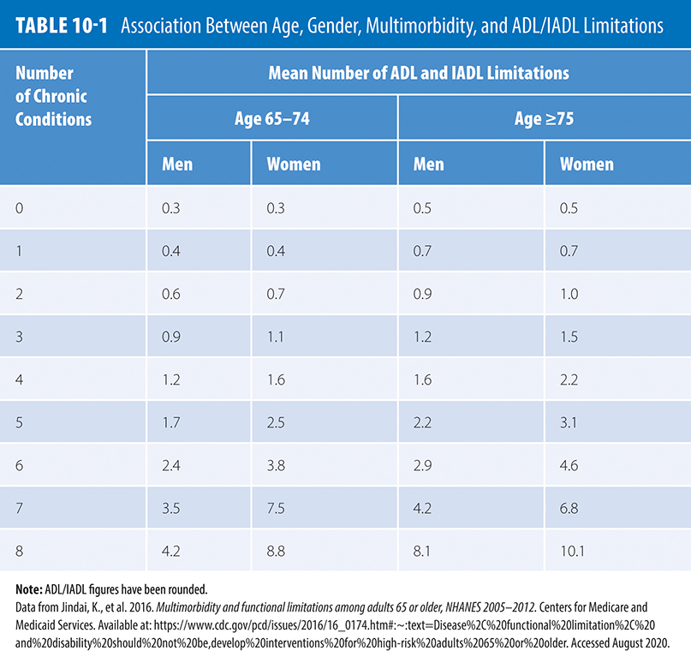



10.T01: Association Between Age, Gender, Multimorbidity, and ADL/IADL Limitations
IADLs
Banking
Buying food/Cooking
Medication management
ADLs
Bathing
Dressing
Eating
Data from Jindai, K. et al. (2016) Multimorbidity and functional limitations among adults 65 or older, NHANES 2005–2012. Centers for Medicare and Medicaid Services. Retrieved August 2020 from
https://www.cdc.gov/pcd/issues/2016/16_0174.htm#:~:text=Disease%2C%20functional%20limita-tion%2C%20and%20disability%20should%20not%20be,
develop%20interventions%20for%20high-risk%20adults%2065%20or%20older.

Slide 12
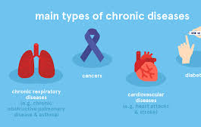
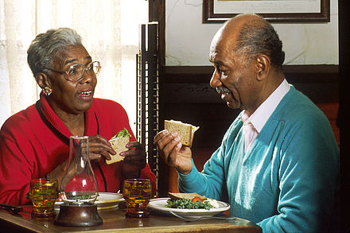
Trends
Growing older adult population
Living longer
Increasing chronic disease burden on system and patients
Rising demand for healthcare services, especially LTC
Escalating costs
This Photo by Unknown Author is licensed under CC BY-SA

Slide 13
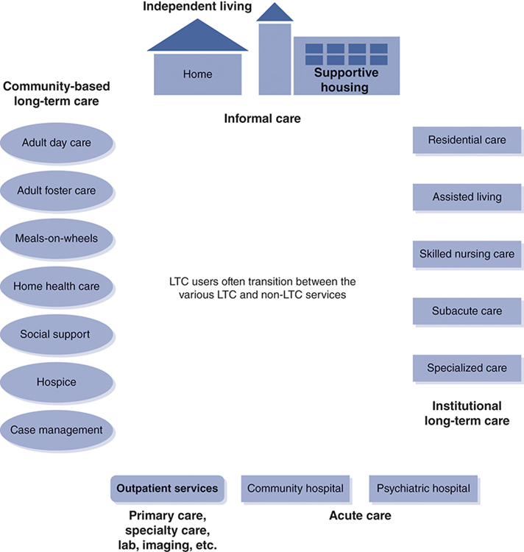
10.F03: Range of services for individuals in need of long-term care
Data from Singh, D. A. 1997. Nursing home ad-ministrators: Their influence on quality of care. New York: Garland Publishing, Inc. p. 15.

Slide 14
Comparison of Community vs Institutional Care
Home and Community Based Services
Adult Day Care
Senior Centers
Home Health
Hospice
Help at Home
Older Americans Act 1965 funding
Section 1915(c) of Social Security Act in 1981
Cost efficient—Medicaid and Medicare
Patient preferred
Improved health outcomes

Slide 15

Comparison of Community vs Institutional Care
Institutional Care
Residential care
Assisted Living
Skilled Nursing/Nursing facility
Subacute care
Specialized care
Increased level of care to total care
Residents vs patients
Medicaid
Costly and often not covered by private insurance or Medicare
Highly regulated

Slide 16


Final Thoughts
LTC is an important sub-system within the greater healthcare delivery system and interacts within it
LTC spans across the community and offers a variety of services
There is a growing demand for LTC services due to a growing older adult population
Home based services are more cost effective than institutional care
Institutional care plays an important role in caring for the most vulnerable populations

Slide 17


THANK YOU

